Slide 1

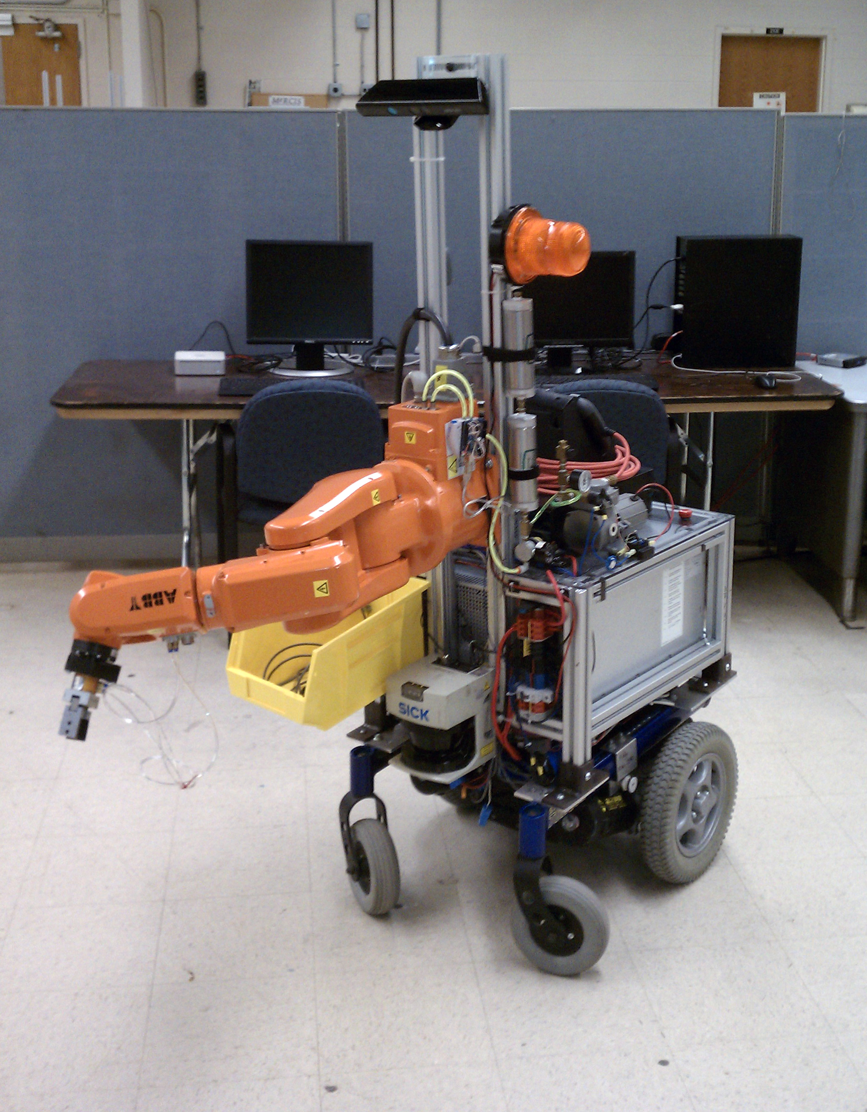
A Low-Cost Mobile Manipulator for Industrial and Research Applications
^{April 25, 2013}
^{Edward Venator}

Slide 2
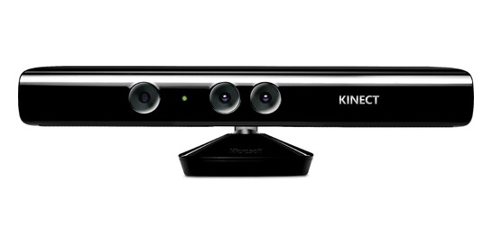
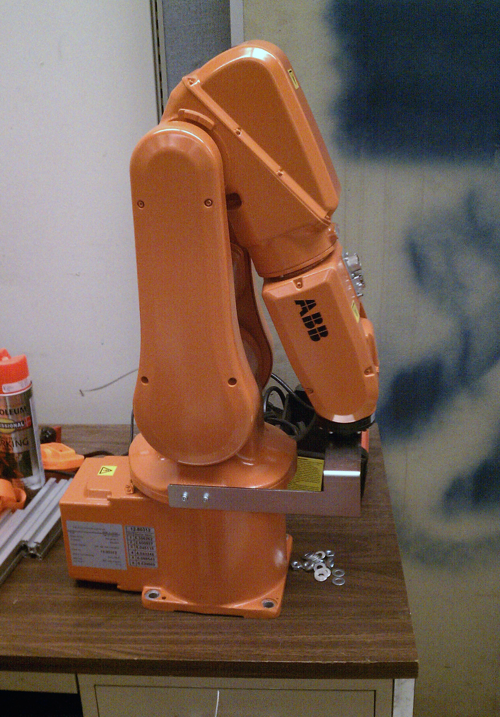
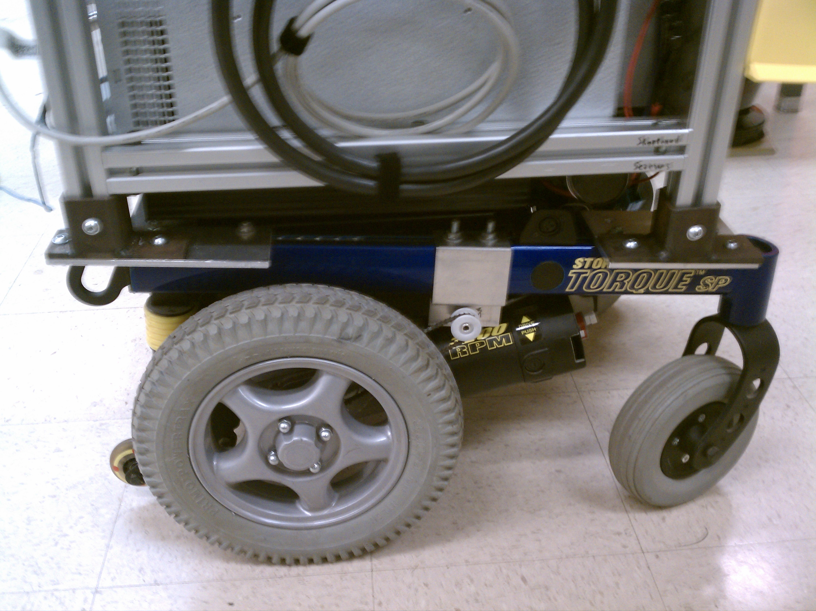

Introduction
Notes:
Introduction
What I did – developed a mobile industrial manipulator
What I used – commercial off the shelf hardware, open source software
Why I did it (goals)
To be used for industrial kitting research
To be used for human-robot interaction research
Low cost
Robust
How long I worked on it – 15 months

Slide 3
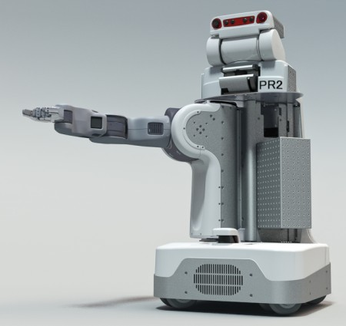
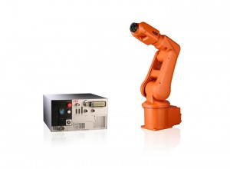
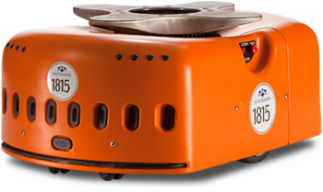
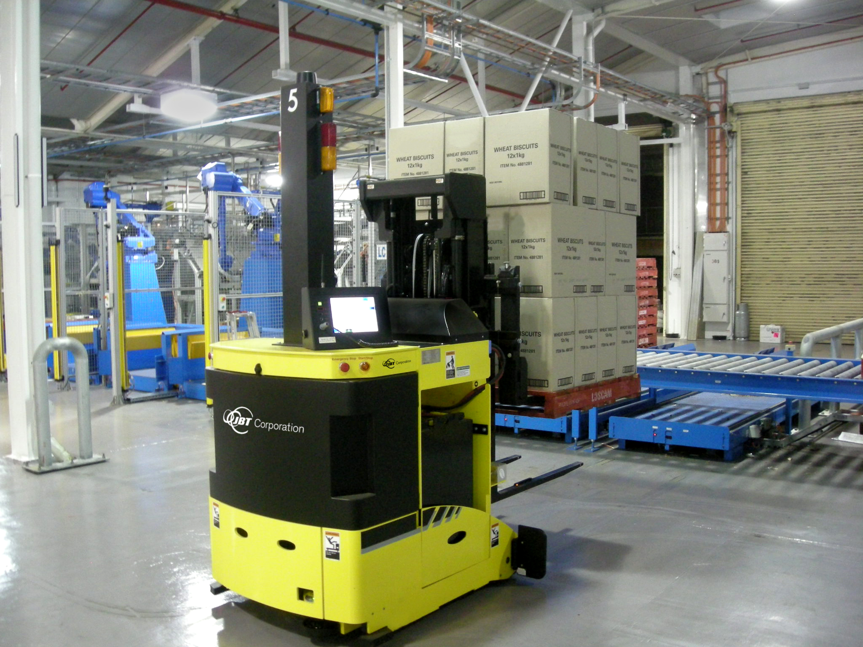
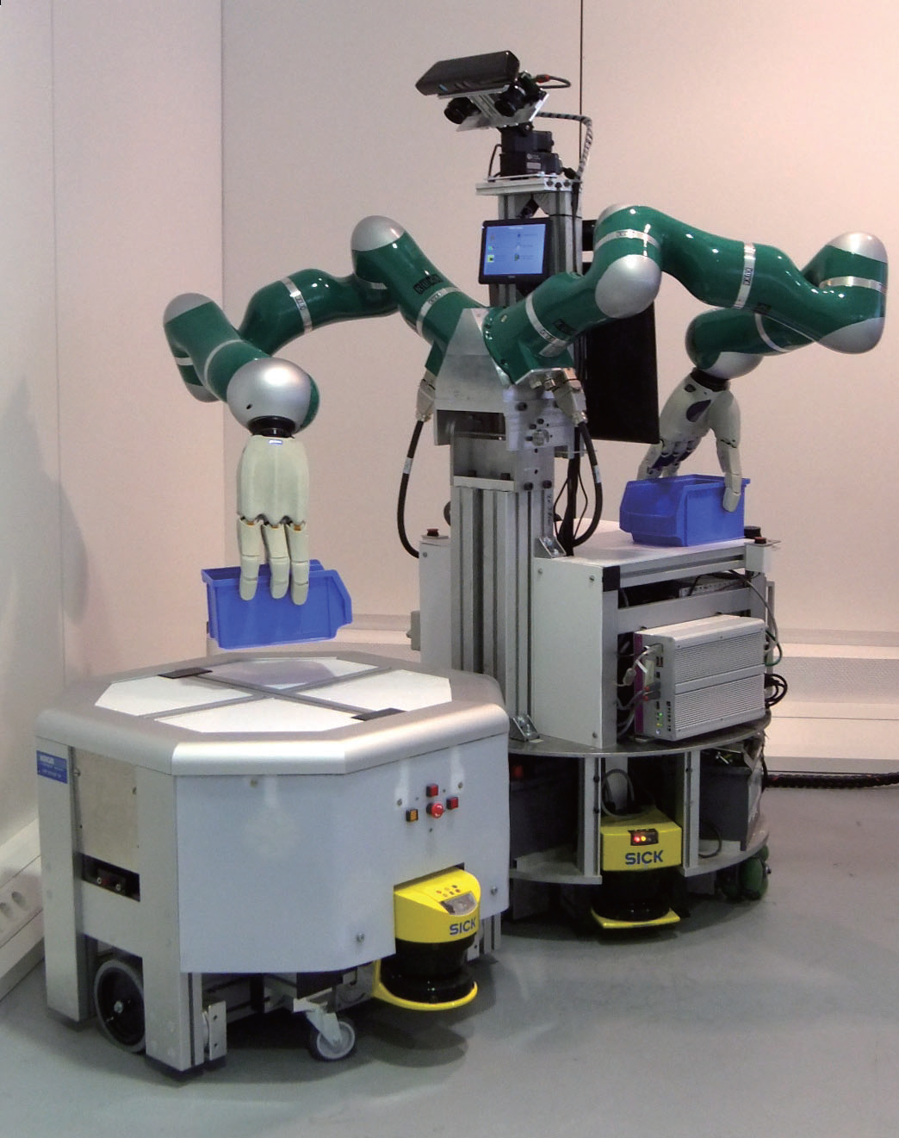
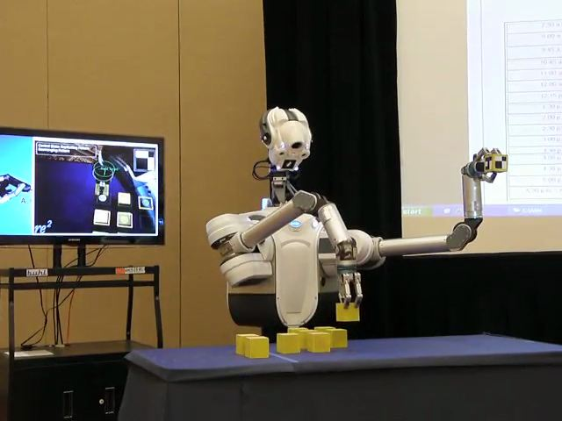
Background
AGV photo courtesy Wikipedia (http://en.wikipedia.org/wiki/File:Agv.forktruck2.jpg)
IRB-120/IRC5 photo courtesy ABB (http://www.abb.com/product/seitp327/BE2EEF38406EACA4C125762000319182.aspx)
PR2 photo courtesy Willow Garage (http://www.willowgarage.com/blog/2011/08/10/announcing-pr2se)
DARPA ARM Robot photo courtesy Hizook.com (http://www.hizook.com/blog/2012/04/03/new-darpa-grand-challenge-humanoid-robots-preliminary-unofficial-details)
IMP photo from Hardware and Software Architecture of a Bimanual Mobile Manipulator for Industrial Application (Proceedings of the 2011 IEEE International Conference on Robotics and Biomimetics)
Notes:
Background
This is a little busy. Clean it up (maybe 2 slides?)
Industry
AGVs vs manipulators
Lack of industrial mobile manipulators
Academic
“Research grade” hardware is not robust
Hardware is very expensive
PR2 ($285k)
Barrett arm $30k each + end effector
Mention DARPA ARM, Verona and IMP
Research/academic vs Industrial
Capable vs cheap
Smart vs reliable
Experimental vs standardized (exception is PR2)
Seeing a new interest in smarter, lighter industrial manipulators
Baxter
ABB Frieda
Universal robot

Slide 4
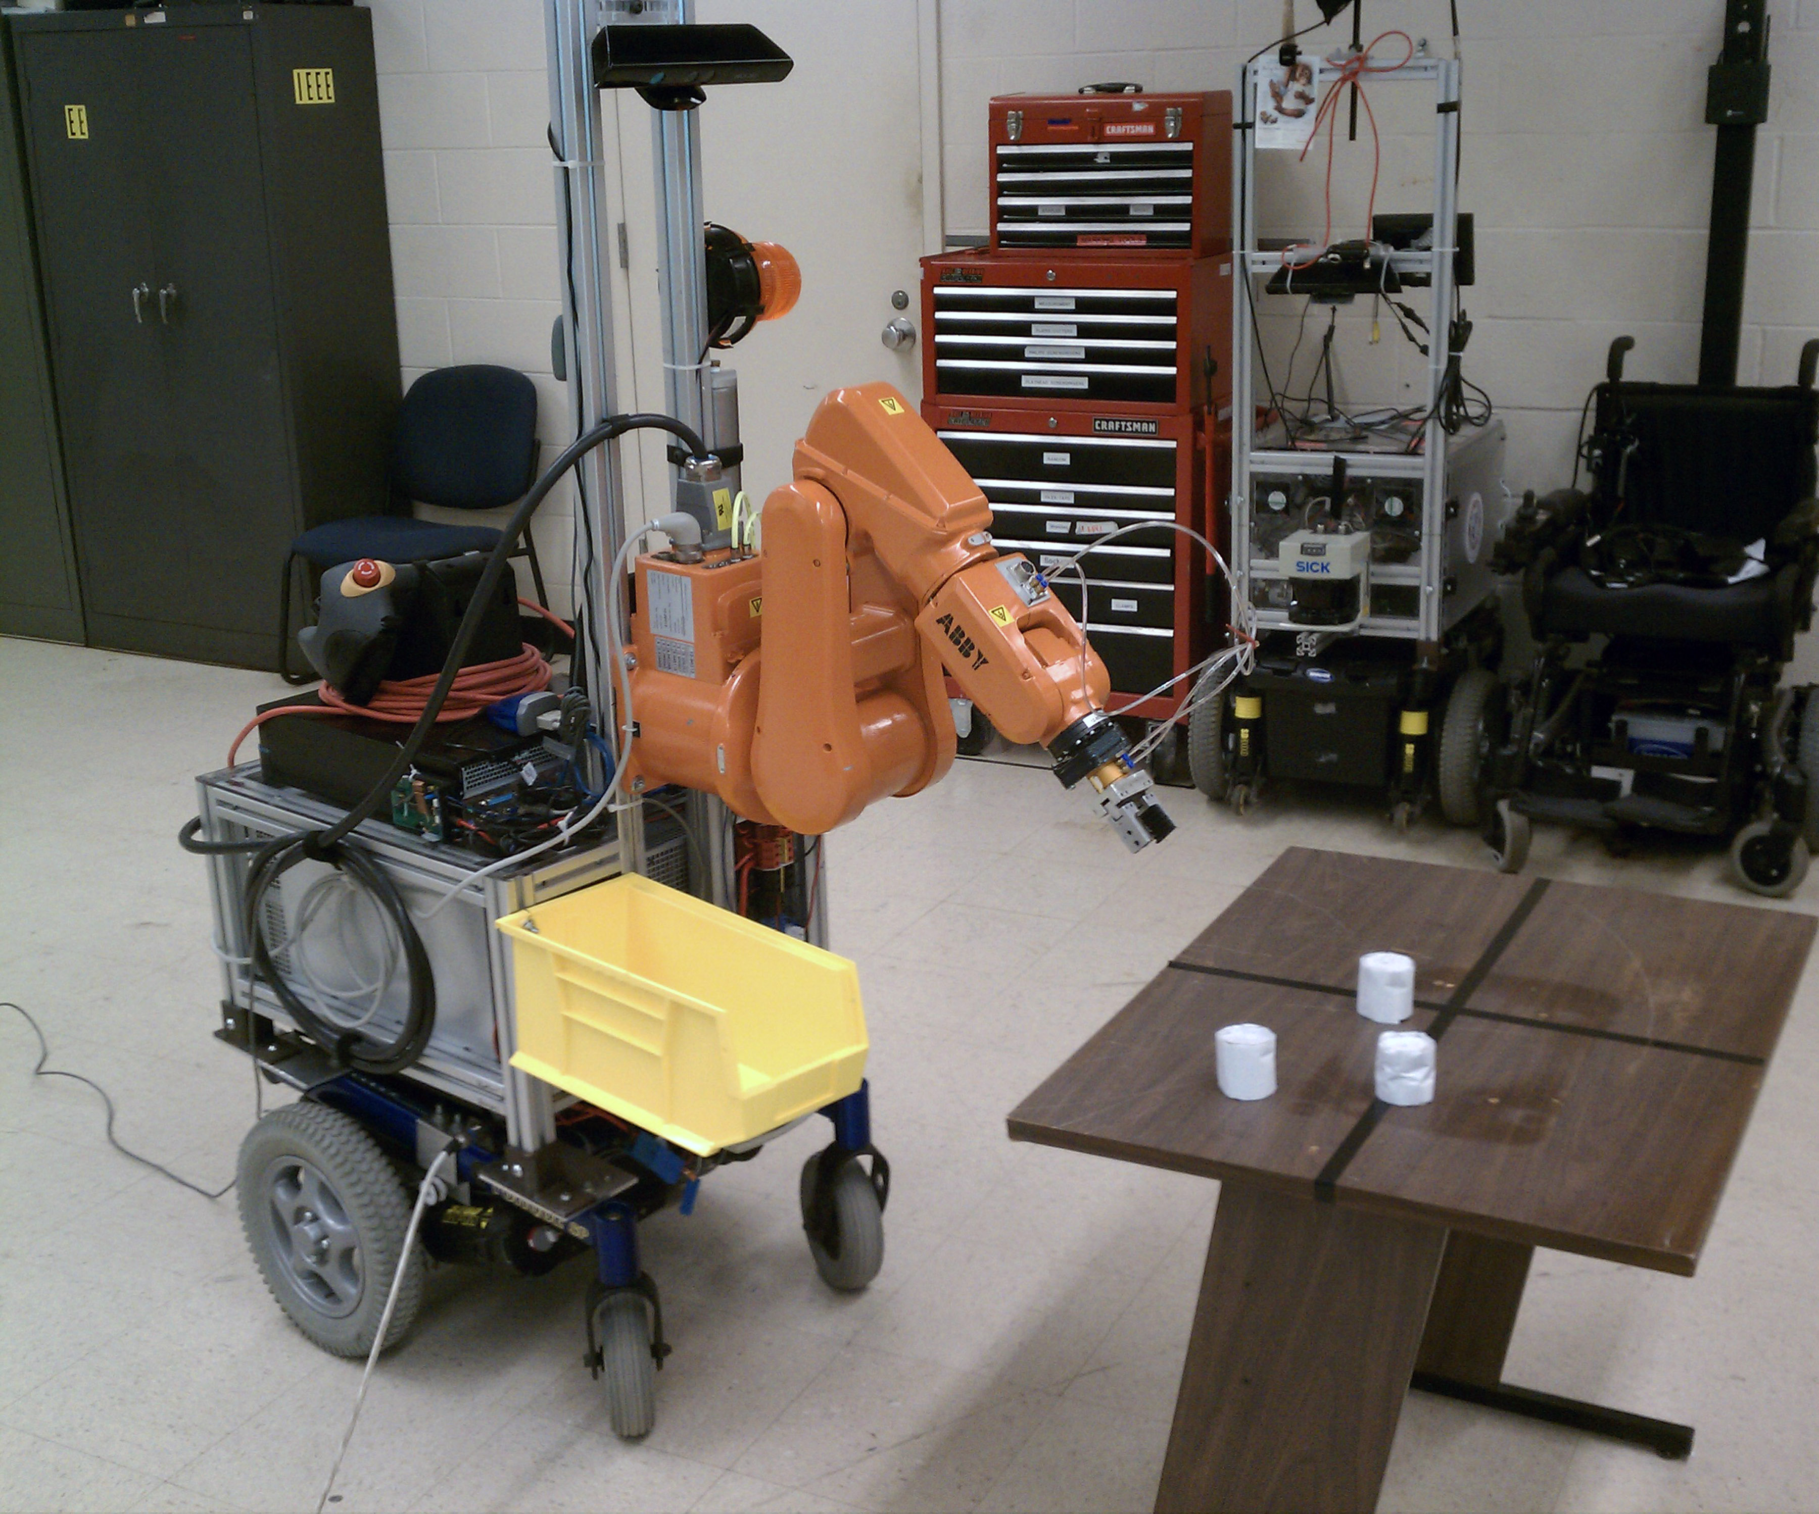
Goals
Mobile manipulation
Robustness
Extensibility
Low Cost
Mass produced manipulator
Mass produced mobile base
Consumer grade sensor
Notes:
Mobile manipulation
Mobile manipulators nearly non-existent in industry
Mobile manipulator replaces a human worker for many tasks
Mobile manipulator can be used to retrieve parts from inventory
Mobile manipulator can be used for reconfigurable manufacturing
Robust
Research grade hardware typically has high failure rate
Industrial hardware typically tested and hardened against failure
Industrial hardware has safety (motion supervision)
Extensibility – This is a platform for future research
Robot has basic capabilities
Software system must be modular to allow future researchers to experiment with new algorithms
Sensors should be usable by future researchers for human-sensing
Low cost – compared to research grade
PR2 Costs $285k
DARPA ARM Costs >$66k
Leverage commercially-available hardware to reduce cost

Slide 5
ABBY – Physical Design
Notes:
Physical Design
Invacare Electric wheelchair base
Payload –
Speed –
Power source – battery capacity
IRB-120 Robot Arm

Slide 6
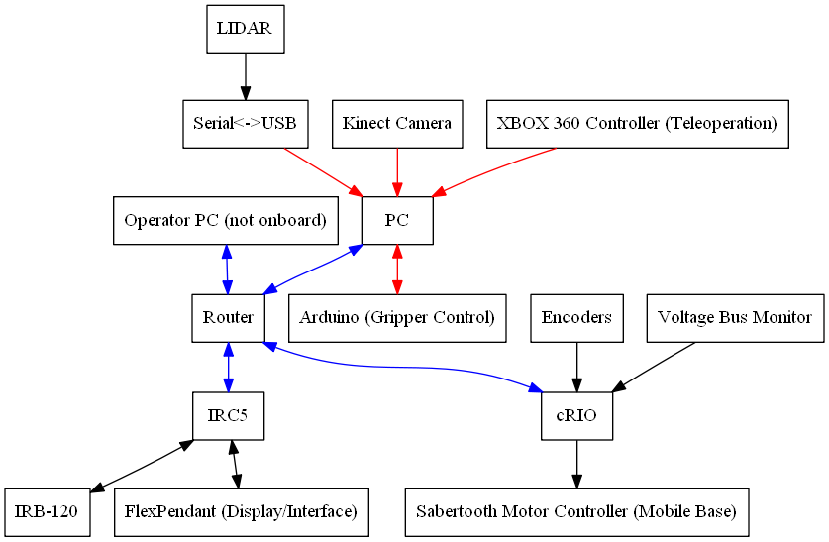
Sensing and Computing
Ethernet
USB
Other
Notes:
Sensing and computing
PC
4 core Intel processor, 8GB RAM
Ubuntu desktop OS
Robot Operating System (you’ll talk more about this on the next slide)
Runs all higher level planning
IRC5
Required to control IRB-120 arm
Realtime OS that runs RAPID code
RAPID is proprietary and kind of clunky
Runs minimal code to control the arm (you’ll talk more about this later)
cRIO (it really doesn’t deserve much time)
Used to control drive base and perform odometry using drive base encoders
Kinect
Low cost RGBD camera mounted high on the robot mast looking down into the manipulator work envelope
Designed as a video game controller
Used as a lower-accuracy replacement for binocular vision systems and tilting laser scanners
Used for obstacle detection and object detection for the manipulator
LIDAR
SICK LMS-291 mounted to the front of the robot
One of the more expensive components of the robot
Used for obstacle detection and absolute localization by the mobile base

Slide 7
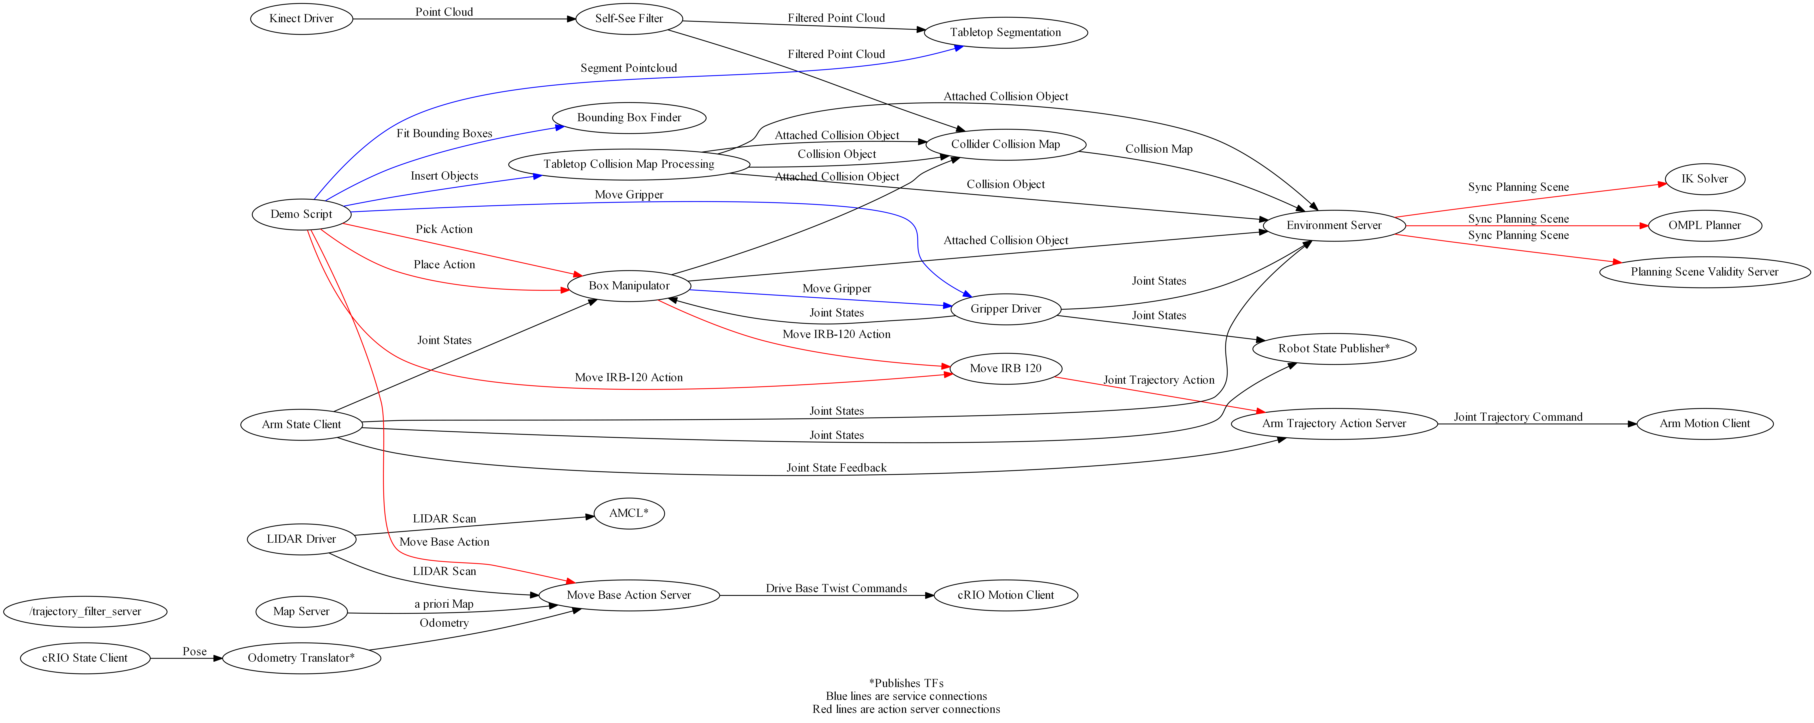
Robot Operating System (ROS)
Notes:
Feature – ROS
ROS is modular and awesome
ROS has existing capabilities
Robot state modeling
Sensor drivers for Kinect and LIDAR
Localization (AMCL)
Mobile base navigation
Arm trajectory planning
Process management, GUI tools

Slide 8
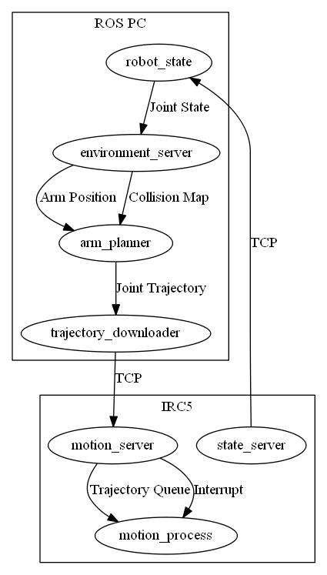
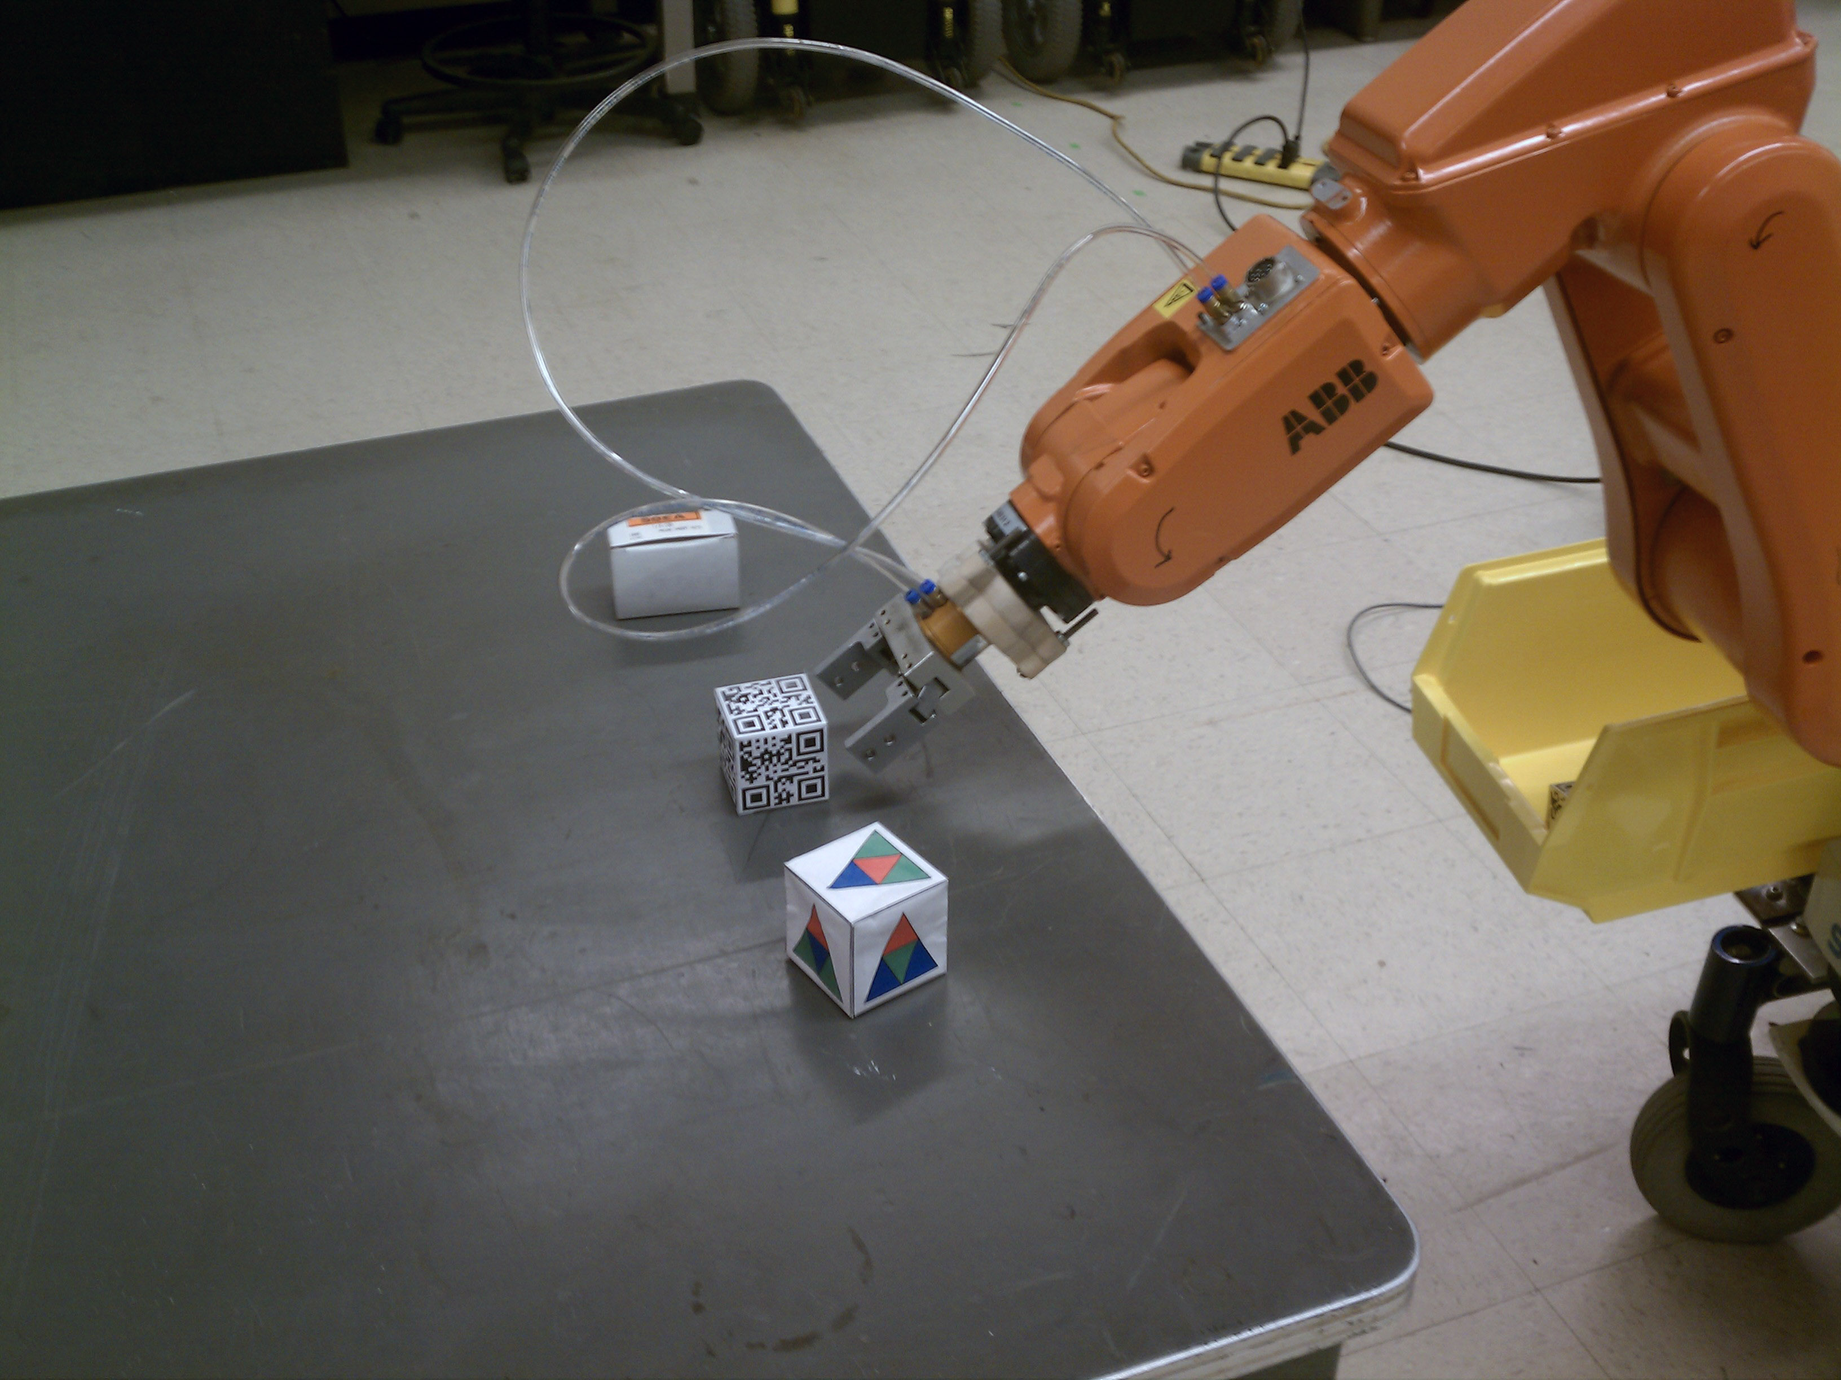
ROS Industrial
Project of Southwest Research Institute
Allows ROS to be used with industrial robots
Standardized interface
This project jumpstarted development of the ROS Industrial ABB driver
Notes:
Feature – ROS Industrial
Picture of arm in Rviz? ROS-I logo? ROS-I block diagram? Arm motion video?
What is ROS-I?
Project of SWRI
Does most of arm planning on PC in ROS
Minimal software on the IRC5 controller (trajectory server, state server, motion process)
Why did I use ROS-I?
Standard platform – many arms supported
Gaining traction amongst researchers
Speeded development
How did I contribute to ROS-I?
Wrote original ABB arm driver – ROS node and RAPID code
This code is the basis for the ROS-I ABB code, which has been improved and released
How does it work?
Uses the ROS standard arm navigation stack for path planning
ROS PC sends a trajectory download to the IRC5
Trajectory defined as sequence of points, each point defined by joint angles
IRC5 receives trajectory, executes it by visiting each point in sequence
No torque control (limitation of IRC5 and of ROS-I)
No velocity control (limitation of ROS-I)
IRC5 reports joint states to ROS PC over the network

Slide 9
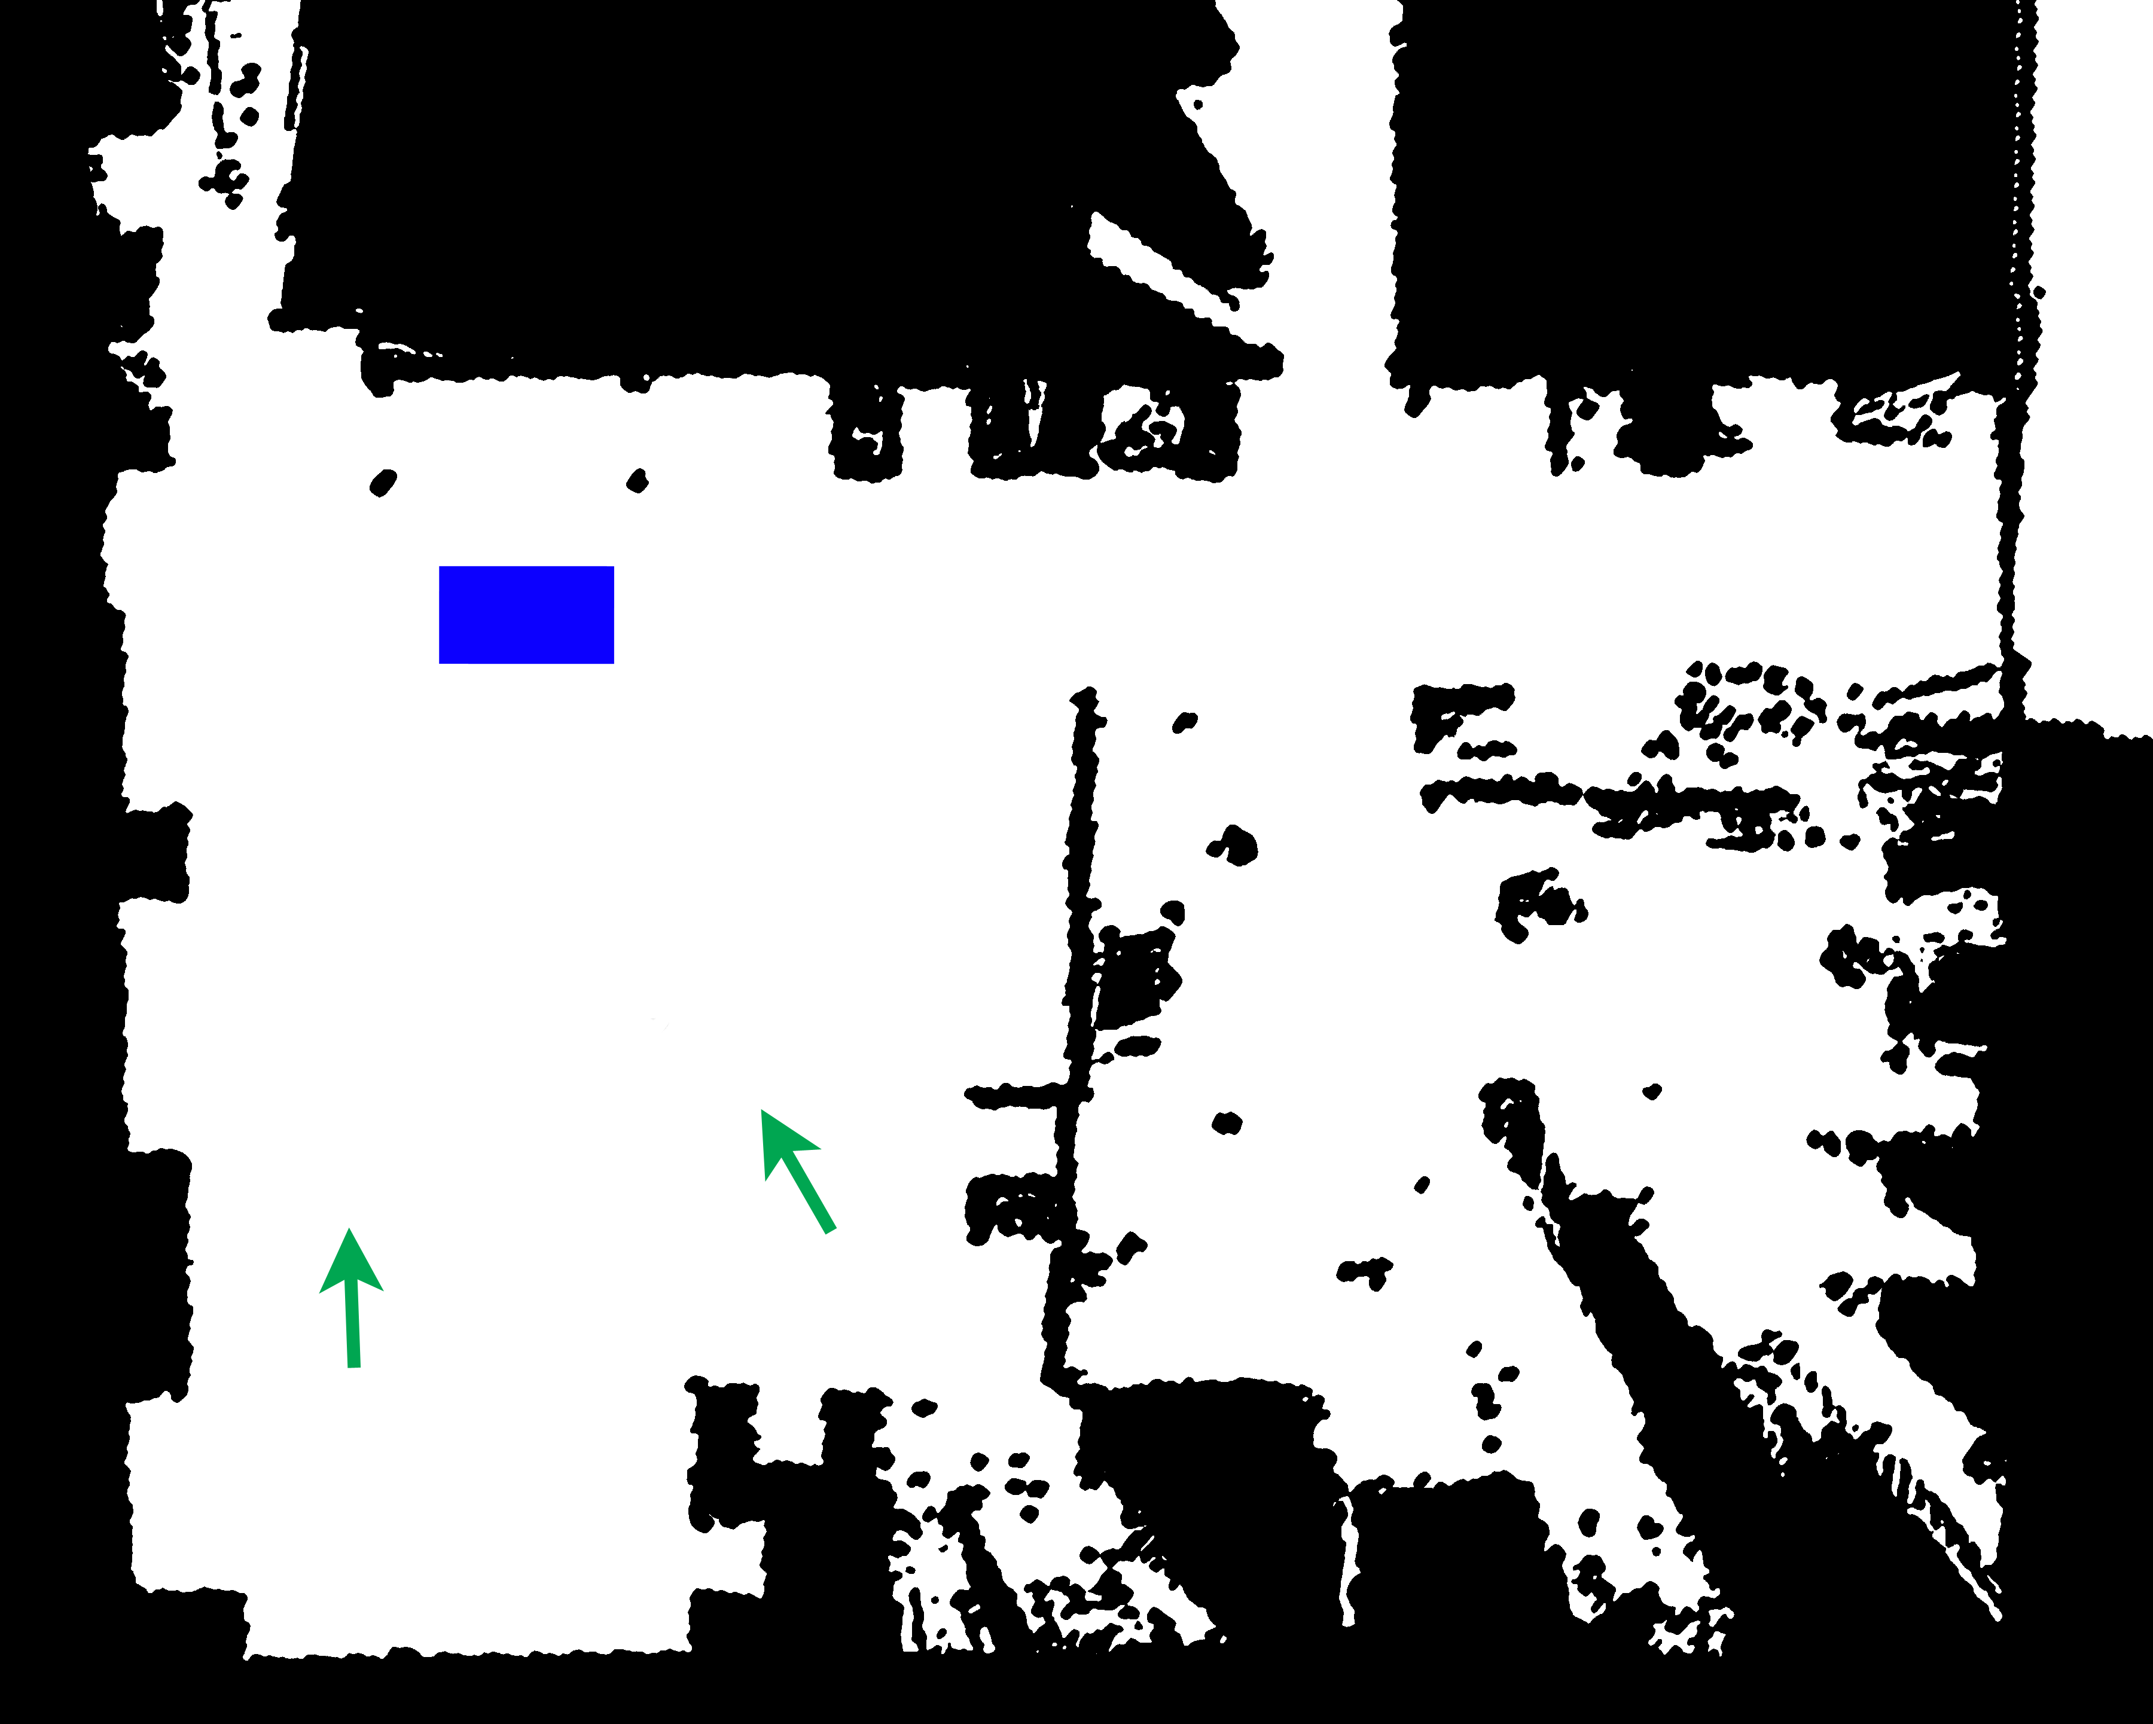
Navigation
Notes:
Capability – Navigation
What this robot can do
Localization
Global planning
Trajectory generation
How done
Odometry and AMCL
ROS NavFN
ROS local_base_planner

Slide 10
Odometry circle data table
Odometry circle scatter plot
Trial | X | Y | Displacement | Position Error
1 | 9.535 | -2.908 | 9.969 | 2.945
2 | 10.042 | -0.760 | 10.071 | 0.761
3 | 10.373 | -0.032 | 10.373 | 0.374
4 | 9.996 | -0.454 | 10.005 | 0.454
5 | 9.881 | -0.663 | 9.903 | 0.674
6 | 10.019 | -0.610 | 10.036 | 0.610
RMS | 9.977 | 1.294 | 10.060 | 1.318
STD | 0.271 | 1.016 | 0.164 | 0.978
Trial | x | y | Oz | Ow | Displacement | Heading (deg)
1 | 0.730 | 0.432 | 0.507 | 0.862 | 0.849 | 29.124
2 | 0.802 | 0.45 | 0.528 | 0.849 | 0.920 | 26.202
3 | 0.941 | 0.596 | 0.613 | 0.790 | 1.114 | 14.370
4 | 0.751 | 0.621 | 0.558 | 0.830 | 0.974 | 22.150
5 | 0.778 | 0.330 | 0.459 | 0.889 | 0.845 | 35.404
6 | 0.892 | 0.434 | 0.502 | 0.865 | 0.992 | 29.677
RMS | 0.819 | 0.488 | 0.530 | 0.848 | 0.954 | 26.975
STD | 0.0833 | 0.111 | 0.053 | 0.034 | 0.101 | 7.235
Notes:
Results – odometry
Maybe rerun these tests w/ AMCL for comparison
Two tests performed
Straight line test – robot is driven for 10 meters in a straight line
Circle test – robot is driven through five laps of a 1 meter radius circle
Results show that odometry is not sufficient for localization
Green is path traveled, red is actual position, and blue are trial results
Absolute localization needs to supplement odometry
AMCL used for absolute localization

Slide 11
Trial | Start Position | Drive To Table | Drive to Final Position
1 | Left | Successful | Several spins at goal position before success
2 | Left | Successful | Several spins at goal position before success
3 | Left | Successful | Successful
4 | Left | Successful | Successful
5 | Left | Successful | Successful
6 | Left | Successful | Successful
7 | Left | Successful | Successful
8 | Left | Successful | Several spins at goal position before success
9 | Right | Successful | Successful
10 | Right | Successful | Successful
11 | Right | Successful | Successful
12 | Right | Successful | Successful
13 | Right | Successful | Successful
14 | Right | Successful | Successful
15 | Right | Successful | Successful
16 | Right | Successful | Arrives at goal position, then spins several times and the gripper brushes an obstacle
Notes:
Results – Navigation
Majority of trials were successful
Failed trials all showed the same behavior (spin at goal location)
Failure behavior
A feature of differential drive robots
Probably related to low update rate that local planner ran at (as low as 3Hz) due to overloaded PC

Slide 12

Manipulation
Notes:
Capability – Manipulation
Show short video
Explain portions of manipulation task
Tabletop Object recognition
Object location (bounding boxes)
Rudimentary grasp planning
Arm motion stow->pregrasp->grasp
Gripper closes
Arm motion grasp->retreat
Arm motion retreat->store
Gripper opens
Arm motion store->stow

Slide 13
Trial | Objects Recognized | Pick Result | Drop Result
1 | 3 | Success | Success
2 | 3 | Success | Success
3 | 3 | Success | Success
4 | 2 | Success ( 3rd attempt) | Success
5 | 2 | Missed (gripper nudges table) | Success (with no object)
6 | 2 | Success ( 2nd attempt) | Success
7 | 3 | Success | Success
8 | 4 | Success ( 2nd attempt) | Success
9 | 2 | Success, insecure grip ( 3rd attempt) | Success (object fell)
10 | 3 | Missed | Success (with no object)
11 | 2 | Missed | Success (with no object)
12 | 2 | Success | Success
13 | 2 | Missed (gripper nudges table) | Success (with no object)
14 | 2 | Success (2nd attempt) | Success
15 | 1 | Cannot find a path to the object | N/A
16 | 2 | Gripper hits table | N/A
17 | 2 | Gripper hits table | N/A
18 | 2 | Success | Success
19 | 3 | Success | Success
20 | 2 | Gripper hits table | N/A
21 | 1 | Success, insecure grip ( 3rd attempt) | Success (object fell)
22 | 2 | Success | Success (takes over 60 s)
23 | 2 | Gripper hits table | N/A
24 | 3 | Success | Success
25 | 2 | Missed | Success (with no object)
Notes:
Results
Majority success
Failures primarily due to collisions with table
Cause unknown
Arm planner should plan collision-free trajectories
Appears to be neglecting the gripper
Area of future work
Missed Picks
Objects are 5 cm diameter; gripper is 5.3 cm opening
No path to object
Kinect view occluded 2/3 objects on table
Object grasping code rudimentary proof-of-concept, only attempts one grasp angle

Slide 14
Simulated Kitting Task
Beginning at one of two starting locations, drive to a predetermined location near a table a few meters away.
Locate at least one of three small manipulable objects on the table using the Kinect.
Lift one of the target objects from the table.
Place the target object in the onboard carrier bin.
Drive to the final destination.
Notes:
Capability – Simulated Kitting Task
Meant to simulate the task of getting at object from inventory
Table represents a shelf
Cylindrical objects represent parts for an assembly
In a real situation, steps 1-4 are repeated until all objects in the kit are picked up

Slide 15
Trial | Start Position | Objects Recognized | Notes
1 | Left | 2 | Robot spins before settling into final position
2 | Left | 2 | Gripper brushes table and knocks over 1 object; robot spins before settling into final position
3 | Left | N/A | Robot approaches table, but get stuck in spin
4 | Left | 1 | Object recognition/pickup succeeds on fourth attempt
5 | Right | 1 | Low batteries prevent robot from aligning in final position
6 | Right | 2
7 | Right | 1 | Low batteries prevent robot from aligning in final position
8 | Right | 3 | Robot spins before settling into final position
Notes:
Results
Majority success
Spinning behavior from navigation tests still evident
Single failure also a result of the spinning behavior (only time this was observed at the table)

Slide 16
Notes:
Results – Mobile manipulation
Video 2 -3 minutes

Slide 17
Questions
Thanks To
ABB (for loan of the IRB-120 and IRC5)
Dr. Wyatt Newman (former advisor on the project)
Dr. Gregory Lee (project advisor)
Dr. Chris Roberts, Eric Perko, and Chad Rockey

